Slide 1
Module-4
Markov Processes with Continuous State Space

Slide 2
Content
Brownian motion
Wiener process
Differential equations for a wiener process
Kolmogorov equations
First passage time distribution for wiener process.

Slide 3
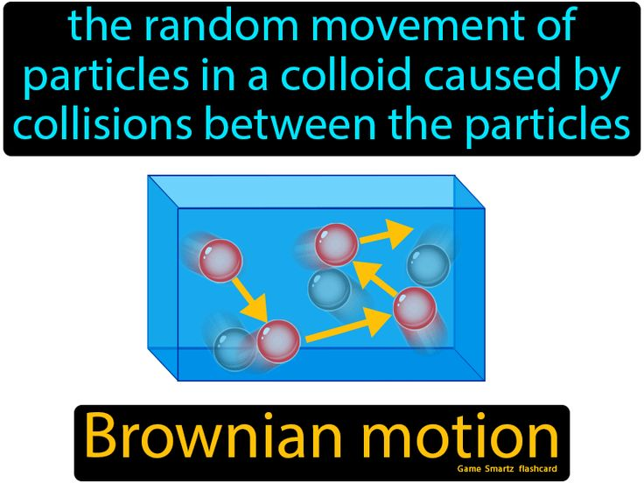
Brownian Motion
“Brownian motion refers to the random movement displayed by small particles that are suspended in fluids. It is commonly referred to as Brownian movement”. This motion is a result of the collisions of the particles with other fast-moving particles in the fluid.
Brownian motion describes randomness and chaos. It is one of the simplest models of randomness.

Slide 4
Brownian Motion
The size of the particles is inversely proportional to the speed of the motion, i.e. Small particles exhibit faster movements.
This is because the transfer of momentum is inversely proportional to the mass of the particles. Lighter particles obtain greater speeds from collisions.
The speed of the Brownian motion is inversely proportional to the viscosity of the fluid. The lower the viscosity of the fluid, the faster the Brownian movement.
Viscosity is a quantity that expresses the magnitude of the internal friction in a liquid. It is the measure of the fluid’s resistance to flow.

Slide 5
Brownian motion is a continuous-time, continuous-state stochastic process, also called the Wiener process.

Slide 8
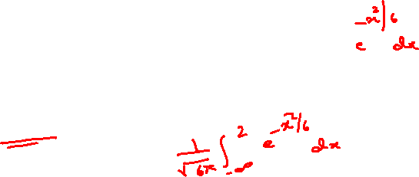
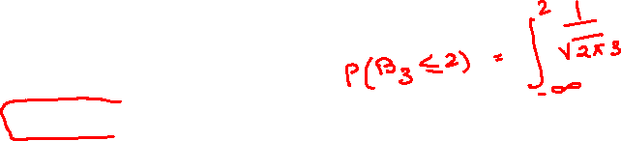
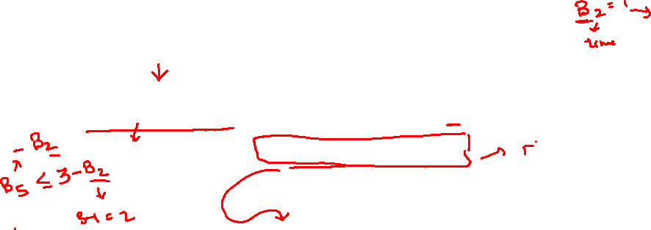

Slide 9
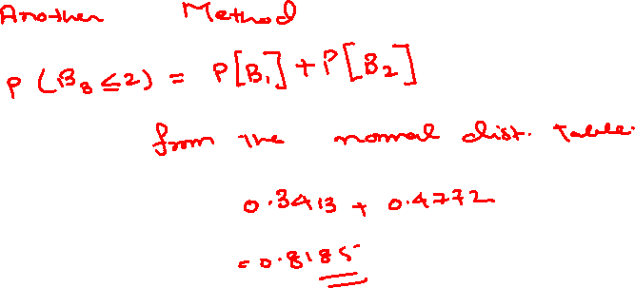

Slide 10
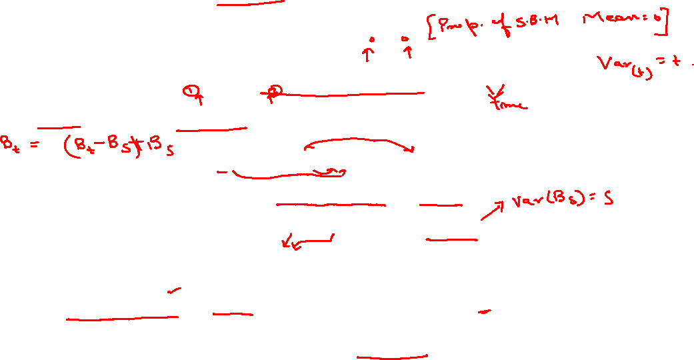

Slide 11
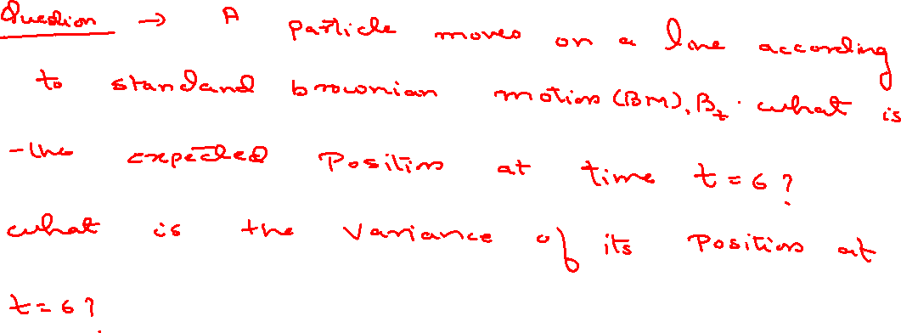
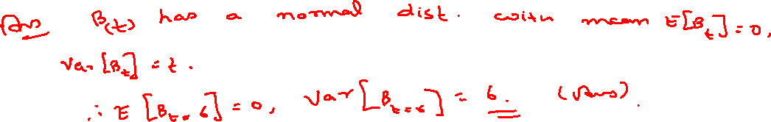

Slide 12
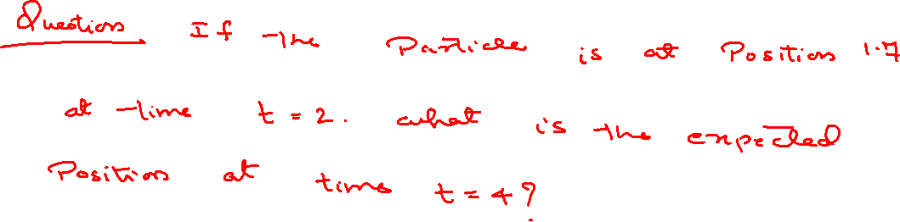
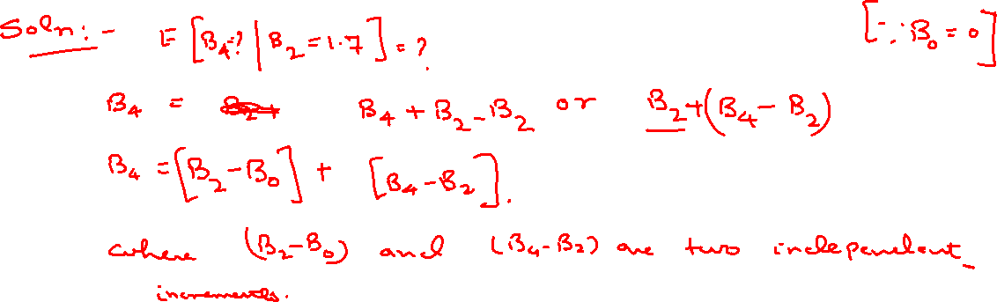

Slide 13
